Slide 1
分組作業競賽 (bonus for 1st accomplished group: 5%)
Find out a drifter trajectory that was near to a typhoon track. Calculate the mean speed of the drifter during the typhoon period.
Show a figure with the typhoon track and dates.
Show another figure the drifter trajectory and the mean speed of the drifter.

Slide 2
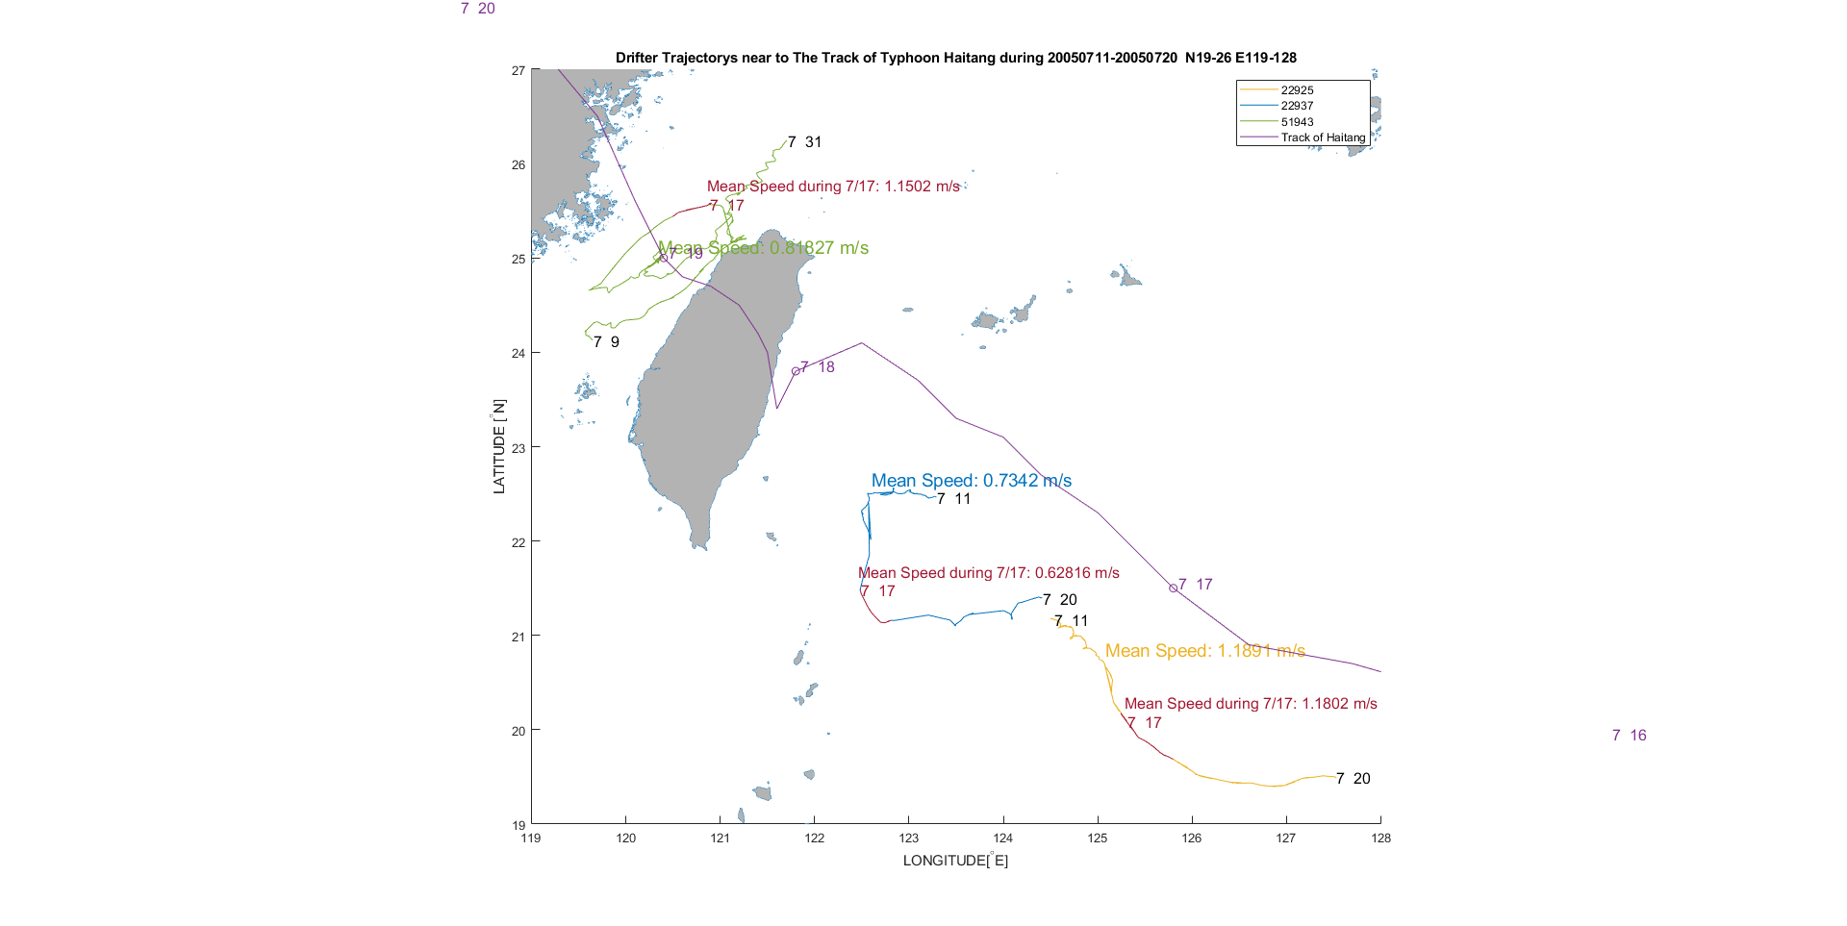

Slide 3
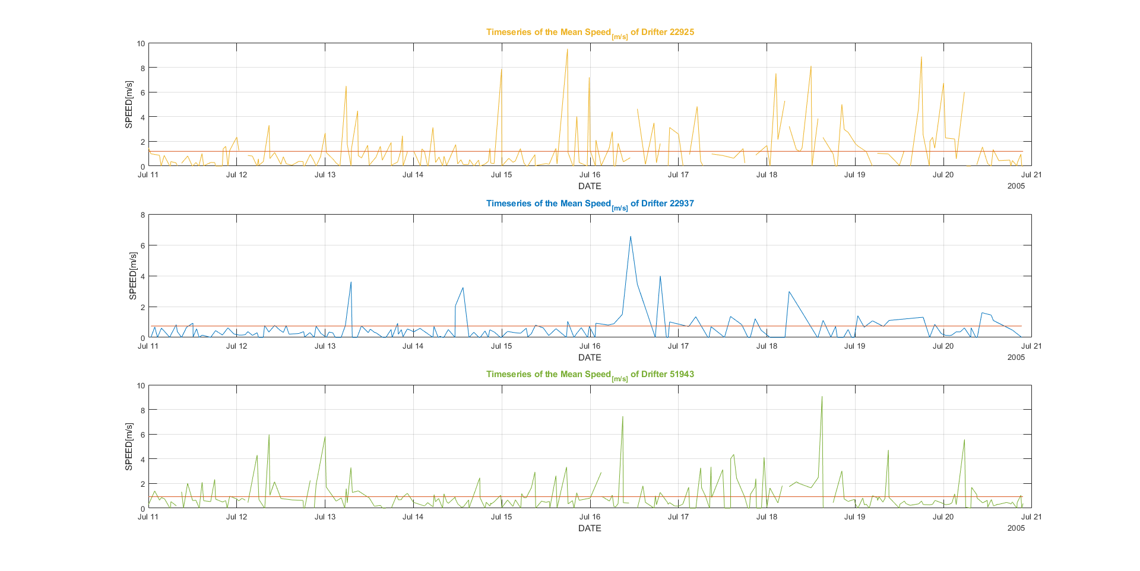

Slide 4
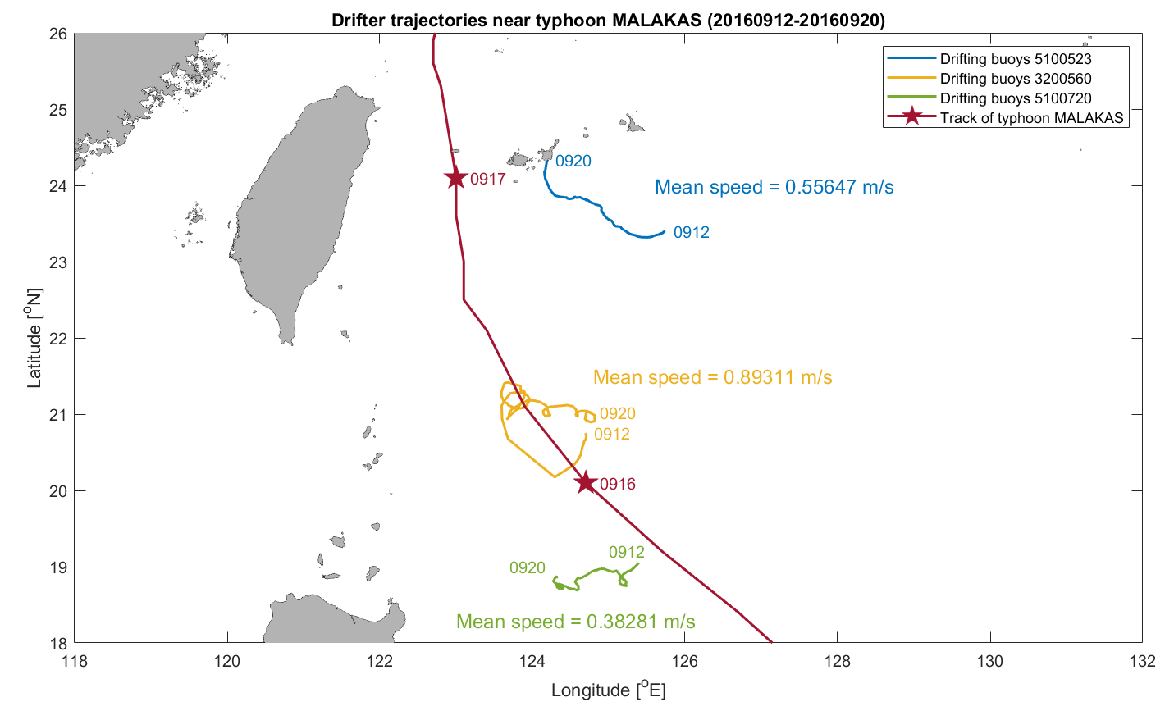

Slide 5
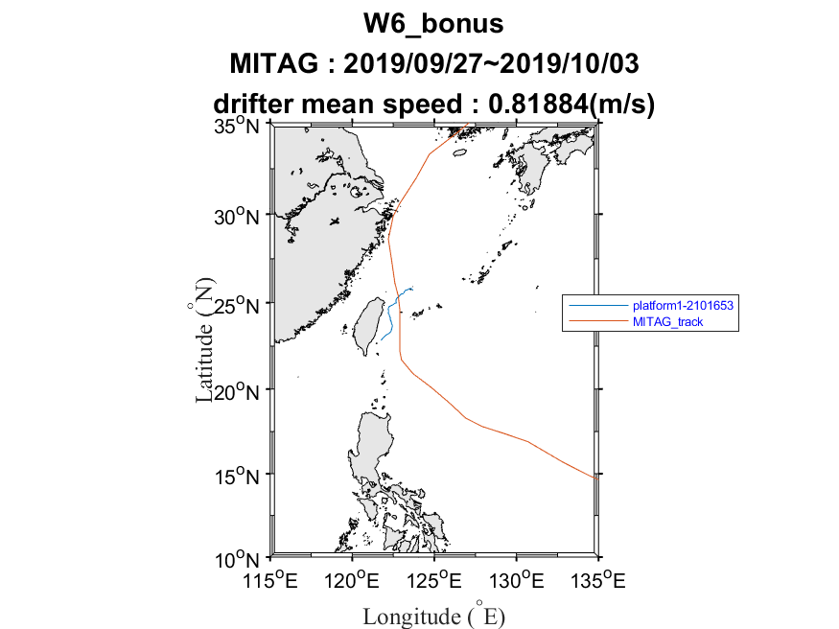

Slide 6
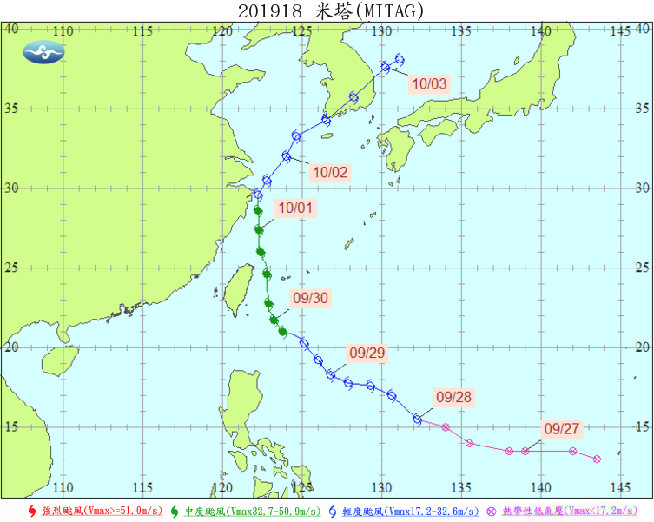

Slide 8
Homework 5 (Discussion)
Compare the pattern of Kuroshio pathway in the periods from 1st November 2015 to 28th March 2016 and from 1st November 2017 to 28th March 2018. (Hint: using drifter trajectories to study the Kuroshio)

Slide 9
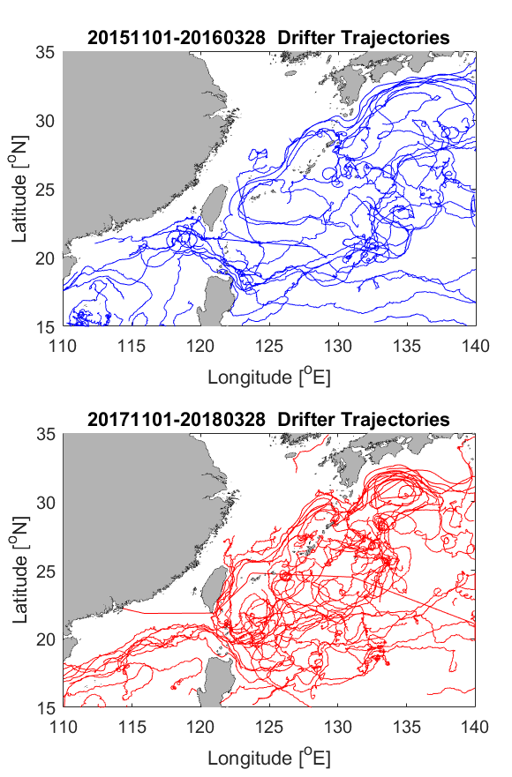
在南海附近，2017年的浮標軌跡相較於2015年有規則，可能是因為2017年黑潮入侵南海的現象較明顯，因此浮標有規律地順著黑潮入侵進入南海；但是2015年浮標的軌跡有進入台灣海峽，而2017年則沒有。另外在日本東邊海域可以發現，2017年黑潮彎曲的幅度較2015年大。

Slide 10
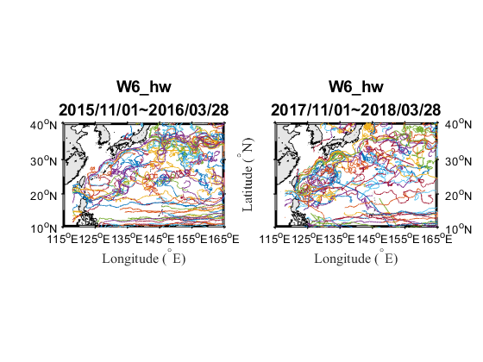
2015到2016年間黑潮入侵台灣海峽的現象較明顯；但在台灣東部外海的流經區域以2017到2018年間較為集中。

Slide 11
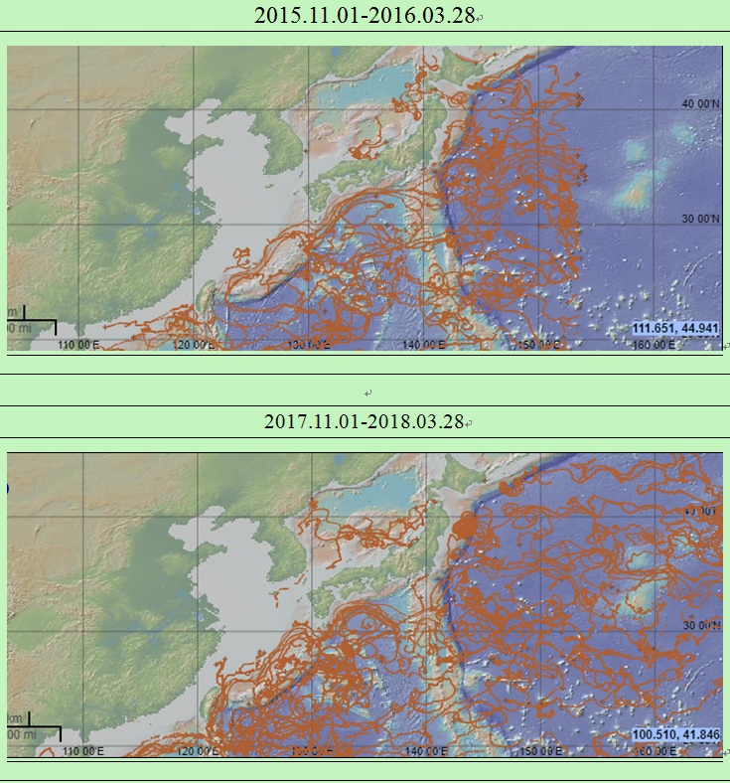
2015.11.01-2016.03.28
1)南海的軌跡較接近珠海附近且靠近台灣。
2)日本海浮標軌跡只在西日本地區；北海道附近海域有浮標軌跡。
2017.11.01-2018.03.28
1) 日本海的軌跡向朝鮮半島延伸；朝鮮半島南方海域有2條軌跡。
2) 軌跡在分布西北太平洋更廣(100-160°E)。
3) 東海偏太平洋海域(120-140°E，20-30°N)的軌跡比較亂且密集。
4) 100°E及比例尺間有浮標軌跡。
5) 東海有軌跡從台灣北方一路朝北至中國延伸。

Slide 12
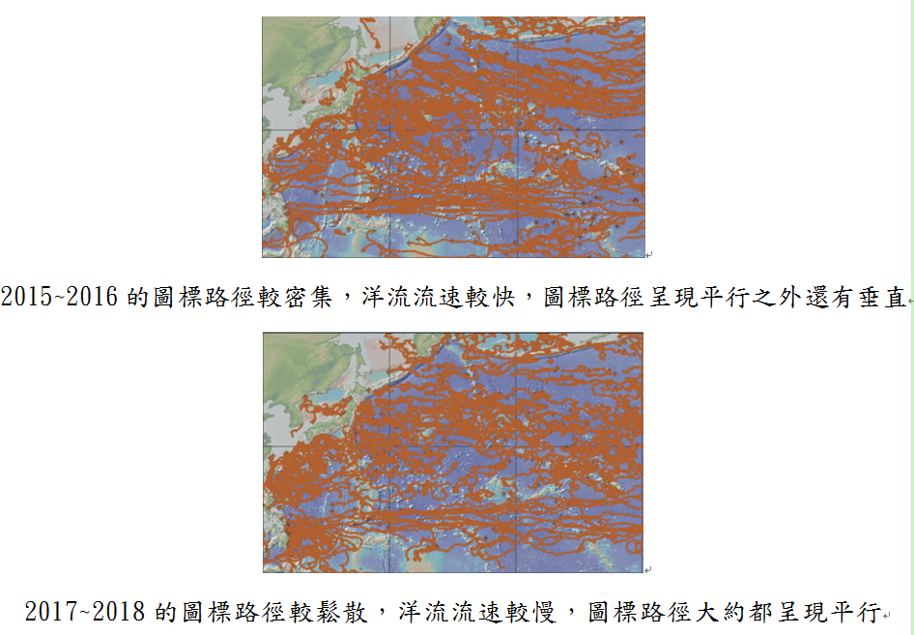

Slide 13
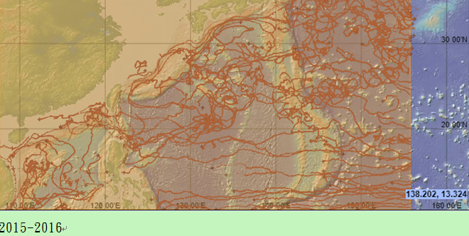
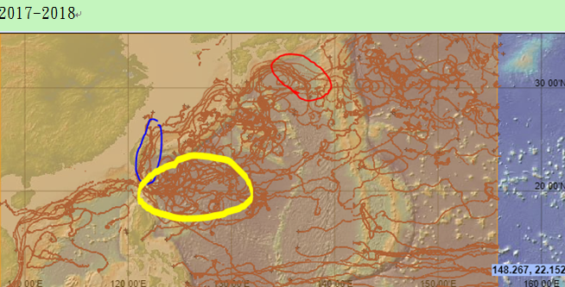
The red part:In 2017 the curve seems more bend
The blue part:In 2017 the current seems closer to East Taiwan than in2015
The yellow part:In 2017 the Drifting buoy circular in a weird part of the sea ,that haven’t been saw in 2015.

Slide 14
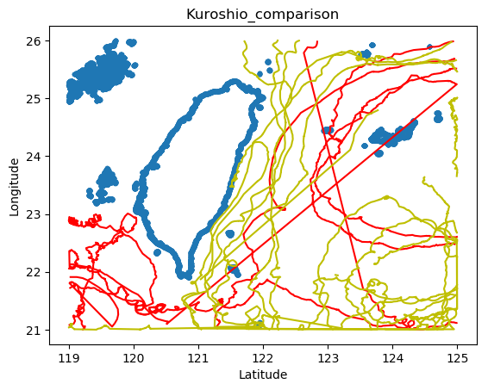
由浮標的追蹤來推測黑潮位置(2015~2016為紅線；2017~201為黃線)：
2017~2018年分布較2015~2016廣
(2) 2017~2018浮標較2015~2016多許多
(3) 台灣西南邊於2015~2016較2017~2018多
(4) 2015~2016於台灣西側幾條非曲線且穿越陸地
(5) 接近台灣北部島嶼的浮標只有2017~2018有，2015~2016則無

Slide 15
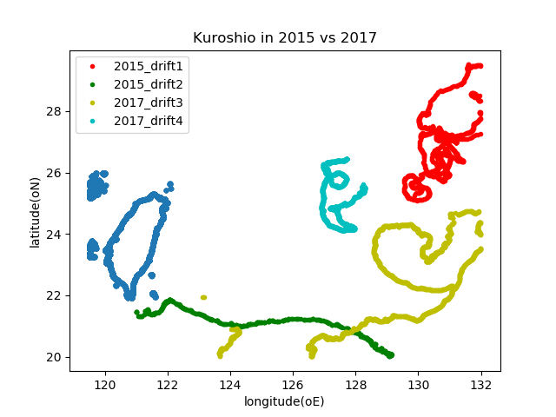
從圖中四個不同浮標可見，因為選取的時一樣長，但2015-2016年的兩個浮標軌跡感覺路徑較長，我的推測是2015-2016年黑潮的流速比同時期2017-2018年黑潮的流速快。

Slide 16
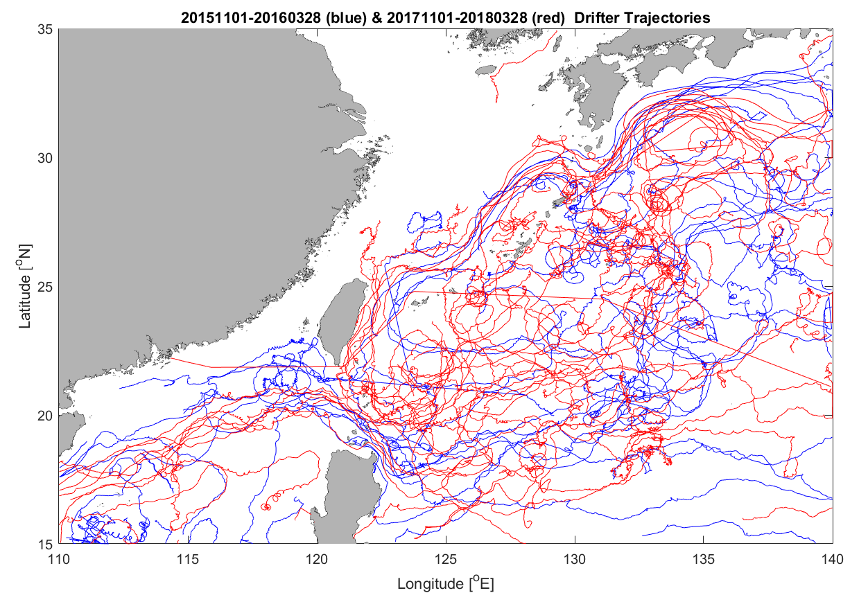
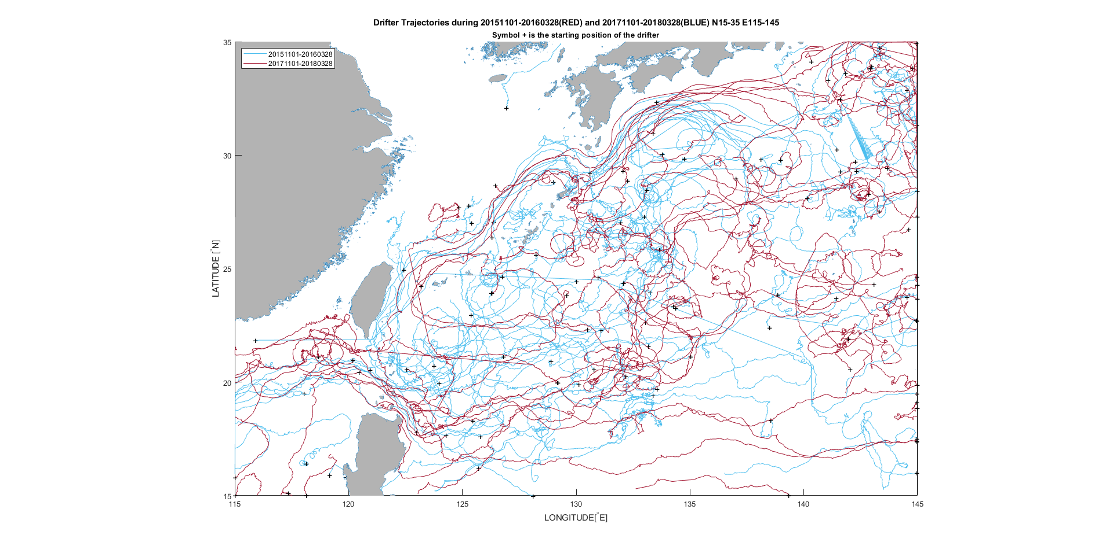

Slide 17
Homework 5 (Discussion)
Compare the pattern of Kuroshio pathway in the periods from 1st November 2015 to 28th March 2016 and from 1st November 2017 to 28th March 2018. (Hint: using drifter trajectories to study the Kuroshio)
Try to google how we human firstly discovered ocean currents. (我們人類最早是怎樣發現洋流的?)
Send your work in a docx word file (filename: hw05_yourname.docx)
to https://driveuploader.com/upload/lVD4ycOKfP/

Slide 18
Homework 5 (Discussion)
Try to google how we human firstly discovered ocean currents. (我們人類最早是怎樣發現洋流的?)

Slide 19
Matthew Fontaine Maury發現海軍艦船上有許多航行於北大西洋的航海日誌，而在這些日誌中記錄了船隻的位置、風速和洋流的速度方向。
在1770年，Benjamin Franklin 也是用了類似的方式發現了灣流，進而編繪了世界上第一幅海流圖「北大西洋海流圖」。(x4)
16世紀時，許多航行於大西洋的探險者，為了要發展貿易、搶奪資源，往國土外發展，發現海流中有不同的流速變化以及方向，也因此發現了洋流的蹤跡。 (reference?)
在大西洋航行的船隻航行一樣的航線中卻出現航行時間不一樣，而發現洋流 (reference?)

Slide 20
年代 | 事件
1513 | 安東．阿拉米諾斯首先發現灣流(墨西哥灣暖流)並研究其流向
1595 | 荷蘭的範．林斯霍特所編的航海誌中，敘述了大西洋的風及海流
1650 | 德國地理學家瓦倫紐斯出版的「普通詆理學」中，歸納了海水溫度和海流等資料，已認識灣流的存在，且有黑潮記錄
1686 | 英國著名天文學家哈雷系統研究主要風系與主要水流，發現它們之間有對應關係
1768~1779 | 英國航海家庫克船長到南太平洋進行海洋科學探險，詳細記錄了途中所經海域的海水溫度與海流狀況
1770 | 美國富蘭克林曾將一些信函分別塞進一個個的漂流瓶子裏，扔入墨西哥灣流中。他在信函中請求發現者回信給他，告訴他發現的時間及地點，因此而獲取了大量的資料，進而編繪「北大西洋海流圖」，這是世界上第一幅海流圖
1839 | Matthew Maury乘坐一海軍軍艦，繪出諸大洋的洋流及風向的型式。 1872~1876年 英國「挑戰者」號由英國海軍及皇家協會支助對海洋做探測，船上置有實驗室、工作間及研究工具，六位科學家、一位藝術家及一大堆幫手。在航行中發現4717種新種海洋生物，也進行深海探測及溫度測量，及深海拖撈工作
1855 | 美國莫里出版「海洋自然諦理學」一書，系統地敘述了海洋與大氣的關係，是近代海洋學的第一部著作，書中還附錄航海導航的海風及海流示意圖
1856 | 美國費雷爾在其所著的「試論風和大洋環流」一文中，說明風及地球自轉偏向力對大洋環流的影響，並描繪出全世界大洋的海流分佈
1872~1876 | 英國「挑戰者」號由英國海軍及皇家協會支助對海洋做探測，船上置有實驗室、工作間及研究工具，六位科學家、一位藝術家及一大堆幫手。在航行中發現4717種新種海洋生物，也進行深海探測及溫度測量，及深海拖撈工作
1925 | 德國Meteor號穿越大西洋14次，利用聲納發現海底中洋脊等海底地形，人類開始ˊ知道海底並不是如原先所想像的那麼平坦
Reference?

Slide 21
Your Sources
https://divediscover.whoi.edu/history-of-oceanography/mapping-current-patterns-in-the-oceans/
https://divediscover.whoi.edu/history-of-oceanography/benjamin-franklin-discovering-the-gulf-stream/
https://www.nationalgeographic.com/news/2012/9/120918-oldest-message-in-a-bottle-science-history-messages/
http://core.ecu.edu/geology/woods/HISTOCEA.htm
https://divediscover.whoi.edu/history-of-oceanography/polynesian-seafarers/
https://www.coastalreview.org/2016/04/13740/; https://en.wikipedia.org/wiki/Oceanography#Early_history
http://163.28.10.78/content/senior/earth/tp_ml/current/cu-index.files/curesult.htm
http://163.28.10.78/content/senior/earth/tp_ml/current/cu-index.files/culhistory.htm

Slide 22
Discussion of Cruise Experiment

Slide 23
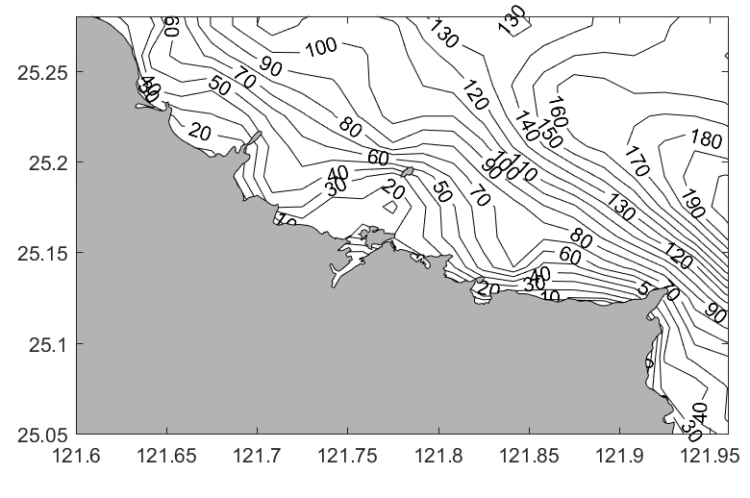
April 30 Cruise (Discussion)

Slide 24
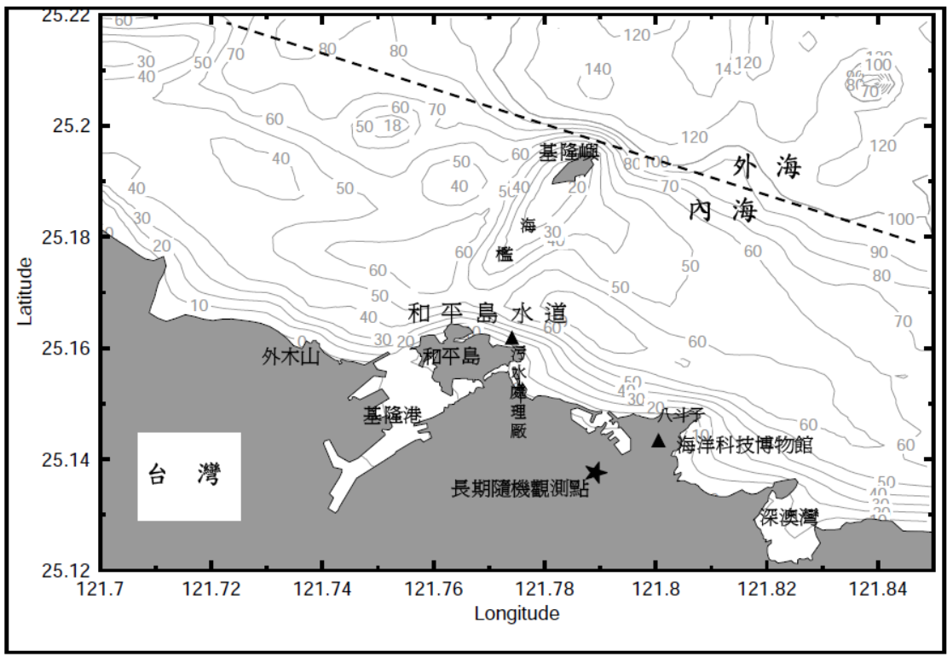
T1
*
C4
*
C3
T2
*
C2
*
C1

Slide 25
Data process and analysis for ship-mounted ADCP (part 1)
ADCP Operation Principles
Ship track

Slide 26
Work to do
1) Install WinADCP
2) Read in ADCP data to WinADCP.
3) Output ship location (Navigation) to a txt file.
4) Plot ship track

Slide 27
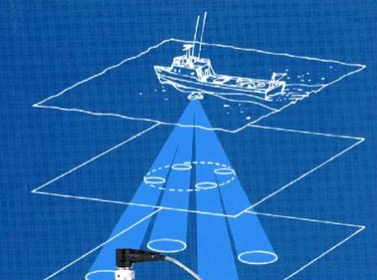
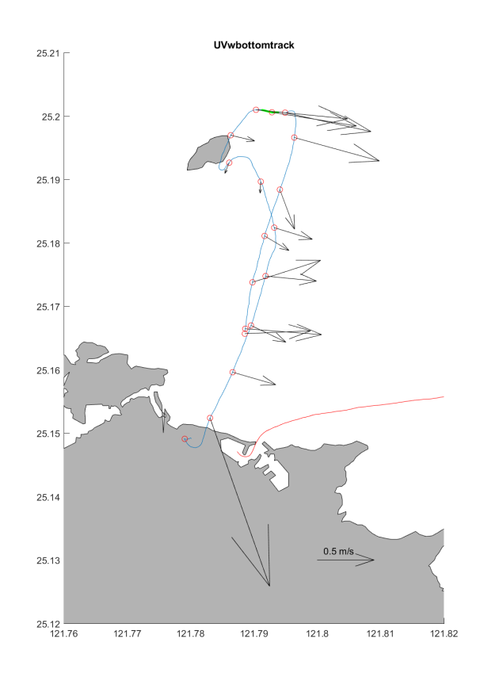
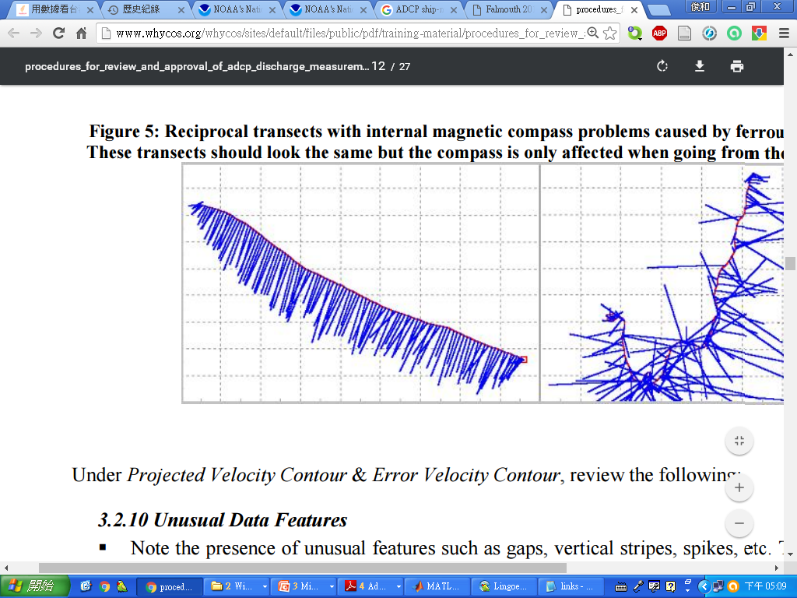
Ship-mounted ADCP
Notes:
http://www.whycos.org/whycos/sites/default/files/public/pdf/training-material/procedures_for_review_and_approval_of_adcp_discharge_measurements.pdf
http://www.soes.soton.ac.uk/teaching/courses/soes3018/2011/Group10/index.htm

Slide 28
Definition of ADCP
Acoustic – Use of a sound wave
Doppler –Doppler Effect is applied to measure velocity
Current - Measurement of water velocity
Profiler - Measurement of a velocity profile, not of a velocity at a point

Slide 29
Acoustic
Send and receive a specific sound to measure the ocean-current velocities

Slide 30
Doppler Shift/Effect in general
https://en.wikipedia.org/wiki/Doppler_effect

Slide 31
Using the Doppler effect
The ADCP sends sound waves that are then reflected by suspended particles, which move with ocean currents.
The particles receive the sound with a shifted frequency because of their velocity (Doppler effect).
The particles reflect the sound waves
Doppler effect is applied 2 times

Slide 32
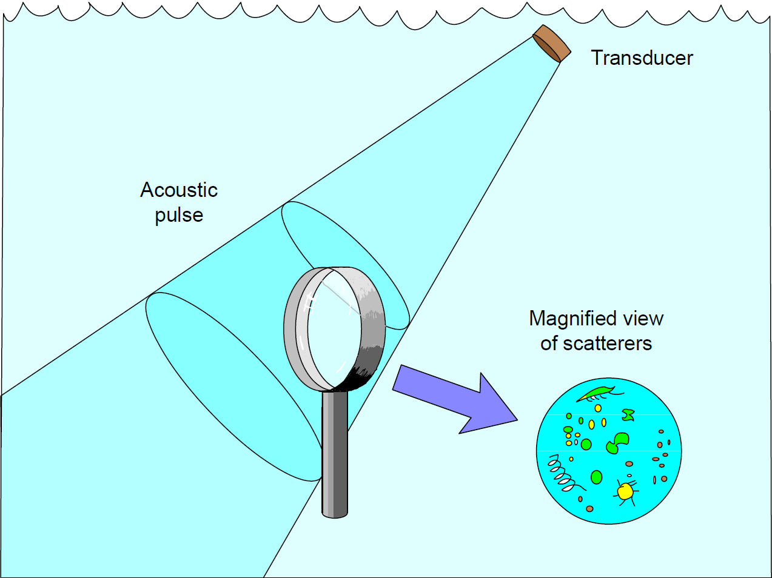
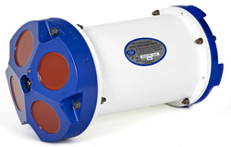

Using the Doppler effect
(音鼓)
Need
suspended
particles

Slide 33
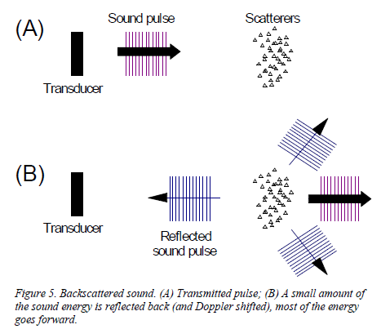
Using the Doppler effect (Backscattering, 散射)
If stationary
(不動或兩者速度一致)
No Doppler Effect
The particles reflect the sound waves
Sources: ADCP Principles of Operation
(A Practical Primer), RDI, 2011

Slide 34
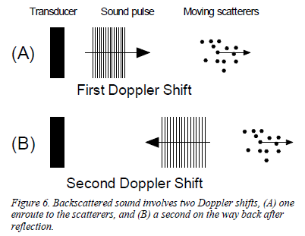
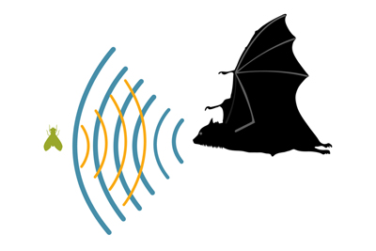
Using the Doppler effect (Backscattering, 散射)
If moving,
Have Doppler Effect
Doppler effect is applied 2 times
Sources: ADCP Principles of Operation
(A Practical Primer), RDI, 2011

Slide 35
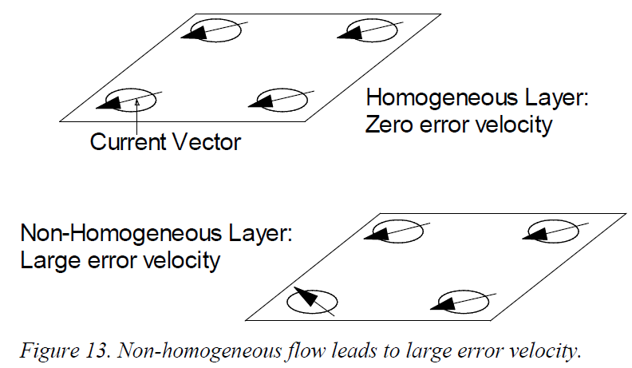
Ocean-Current Homogeneity in a Horizontal Layer
Assuming, the ocean currents at local regions where we measure are homogeneous.
Sources: ADCP Principles of Operation
(A Practical Primer), RDI, 2011

Slide 36
Ocean-Current Homogeneity in a Horizontal Layer
Error velocity: the difference between the two estimates of velocity
Non-homogeneous currents → large error vel.
Large errors of Pitch and Roll → large error vel.

Slide 37
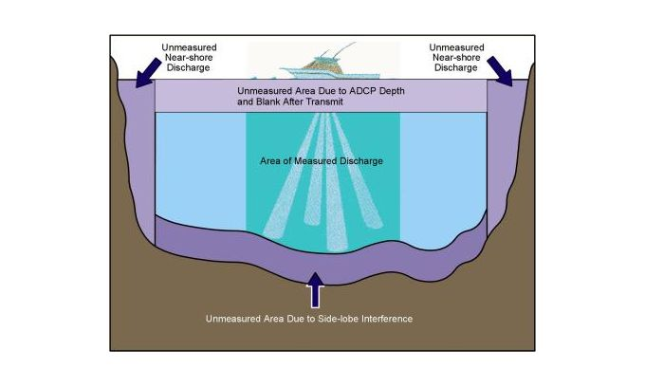
Limitations of ADCPs (Blank regions depending on sound freq.)

Slide 38
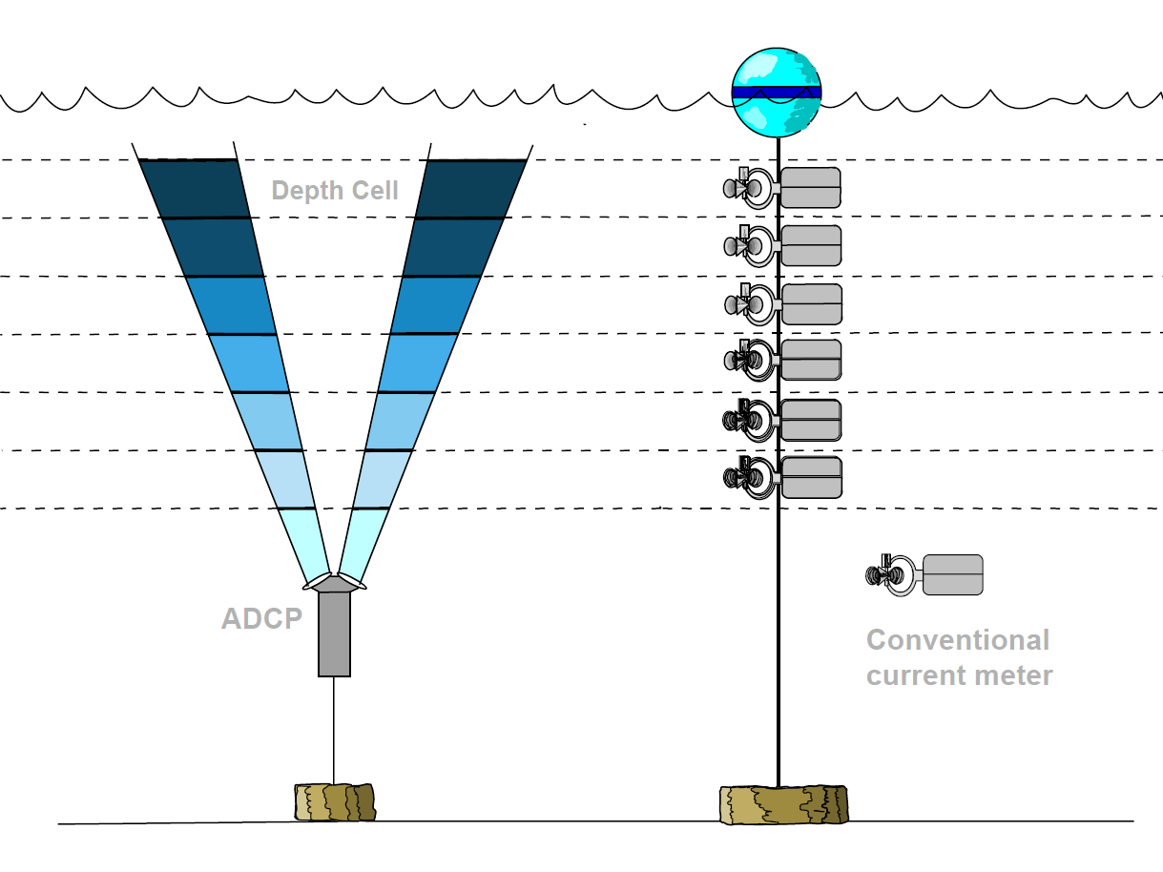
Velocity Profile
Bins=Depth Cell (normally 4m or 8m in Taiwan OR cruises)
Source: IRD - Unite OBHI (Observatoires Hydrologiques et Ingenierie)

Slide 39
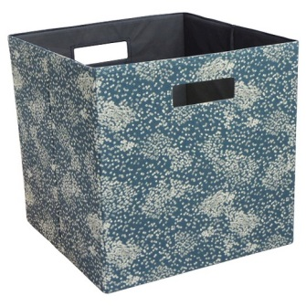
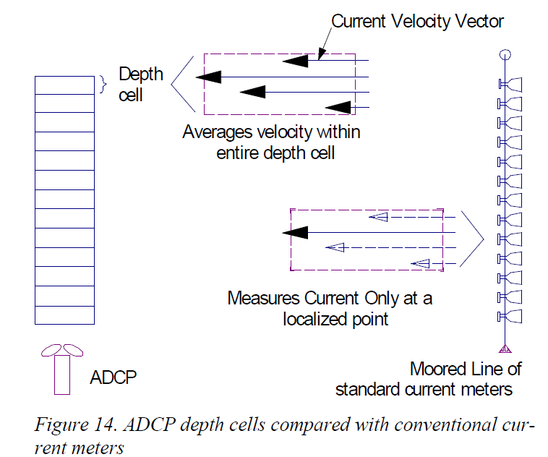
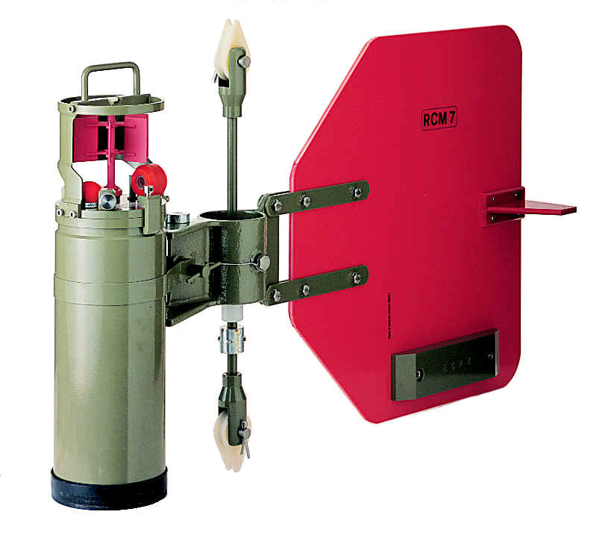
Velocity Profile
Bins=Depth Cell

Slide 40
Velocity Profile
Which one is better? 1 or 2? Why?
1
2

Slide 41
Velocity Profile
Averaging over a range is better, because
(1) the effects of spatial aliasing are reduced.
(2) uncertainty of measurement is reduced.

Slide 42
ADCP standard data

Slide 43
ADCP standard data
■ Velocity → for ocean-current data
■ Echo intensity
■ Correlation → for data quality
■ Percent good
Think: what is the standard data of surface drifters?

Slide 44
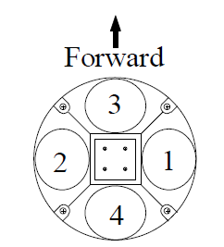
Velocity data
Based on different kind of formats:
Beam coordinates: Velocity is parallel to each beam.
Earth coordinates: Velocity in north, east and up (We want this)
ADCP coordinates: Similar to earth coordinates but the velocity is relative to ADCP
Ship coordinates: Similar to ADCP coordinates except that heading is rotated into ship‘s forward and sideways.
Sources: ADCP Principles of Operation
(A Practical Primer), RDI, 2011

Slide 45
Absolute Current Velocity
Removing the best estimate of ship velocities
Smoothing absolute velocities to reduce the effects of remaining noise in the ship’s position data

Slide 46
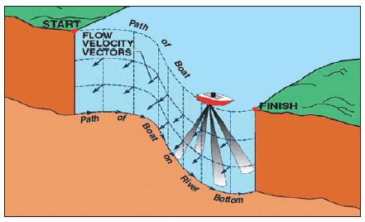
Ship Velocity
Navigation (for shallow and deep regions)
Bottom track (normally better, but for shallow regions where the ADCP’s sound waves can reach the bottom)

Slide 47
Data Quality
Echo intensity: ADCP received signal strength
Correlation: signal to noise ratio
Percent good***: The fraction of good data that passed a variety of criteria (high correlation, low error velocity, …)

Slide 48
Error sources
Noise of instruments
Sound absorption
Misalignment of the transducer relative to the ship’s keel
Interference by physical objects and ship‐induced turbulence
Ship motion

Slide 49
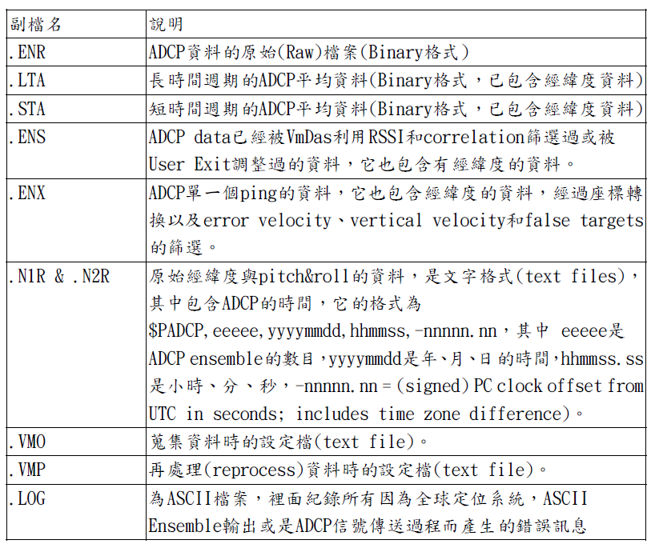
ADCP data files

Slide 50
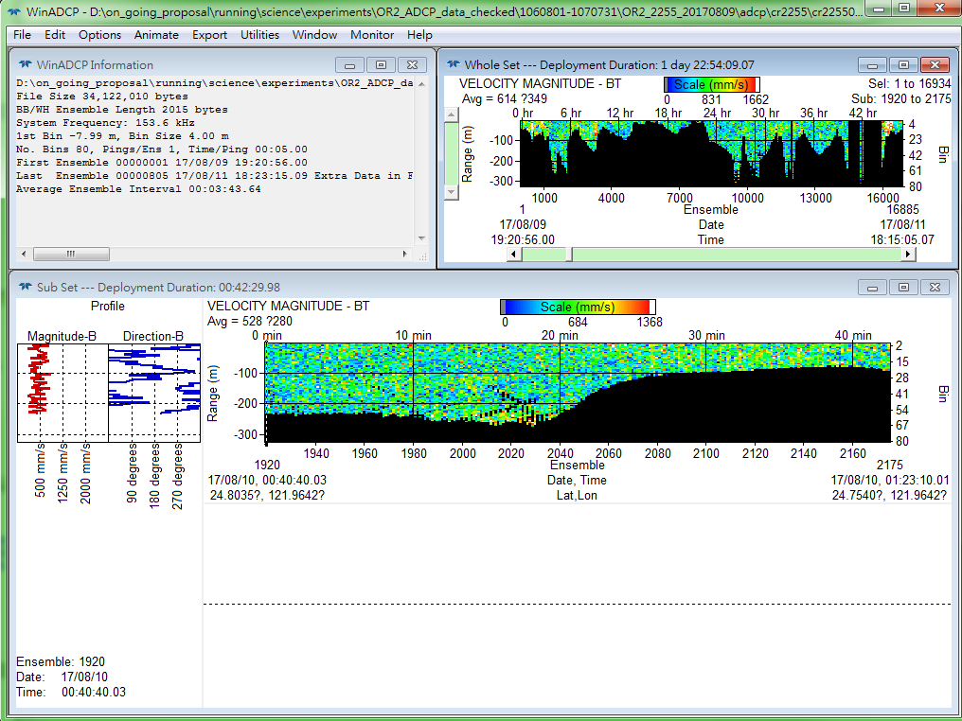
References and Links (Processing Software)
http://www.teledynemarine.com/rdi/support#

Slide 51
Download files from server
WINADCP!.exe (ADCP software)
cr2247001_000000.LTA (ADCP data)
cr2252001_000000.LTA (ADCP data)
Manual:
BBPRIME.pdf (ADCP manual)
ADCP_manual_II.pdf (ADCP manual in Chinese)
WinADCP User Guide.pdf (WinADCP manual)

Slide 52
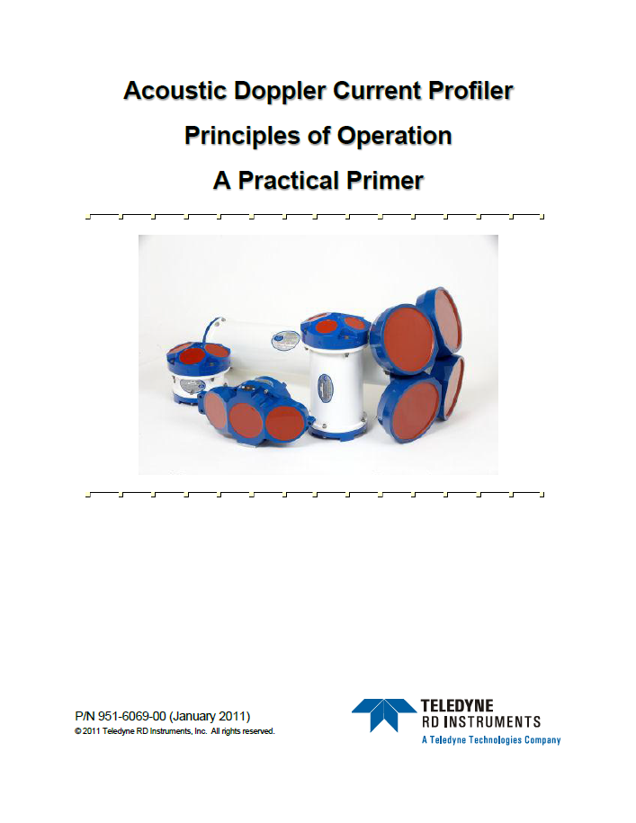
References and Links (Principles 原理)
http://www.comm-tec.com/Docs/Manuali/RDI/BBPRIME.pdf

Slide 53
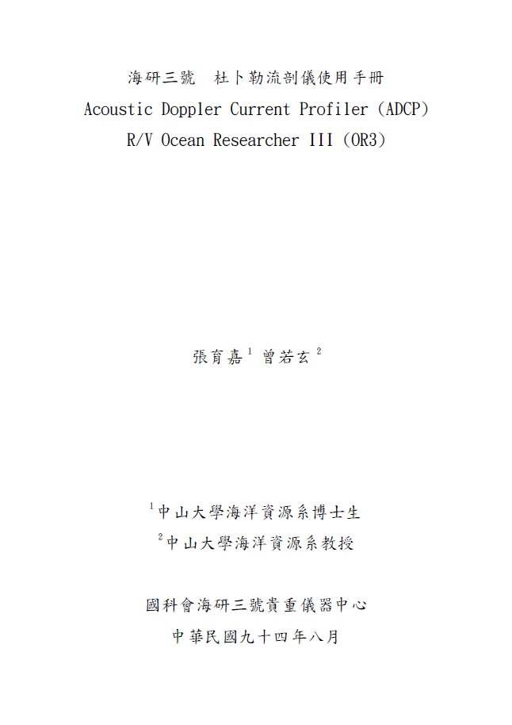
References and Links (Principles in Chinese)

Slide 54
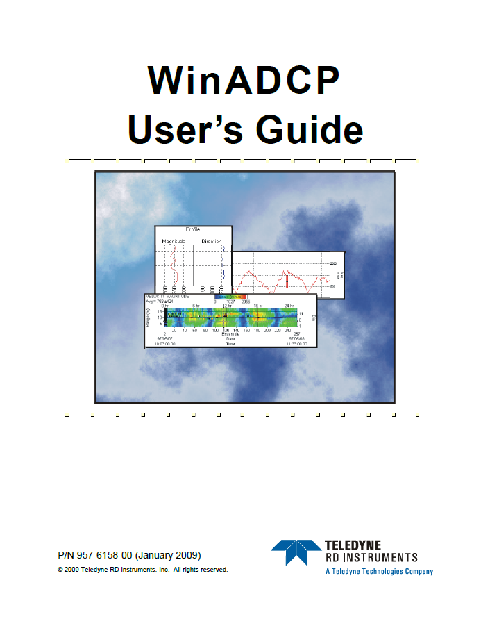
References and Links (Processing Software)
http://www.comm-tec.com/Docs/Manuali/RDI/WinADCP%20User%20Guide.pdf

Slide 55
Ship track
Getting ship-track data from the ADCP measurement using the WinADCP software

Slide 56
Ship Velocity
Navigation (for shallow and deep regions)
Bottom track (normally better, but for shallow regions where the ADCP’s sound waves can reach the bottom)

Slide 57
Absolute Current Velocity
Removing the best estimate of ship velocities
Smoothing absolute velocities to reduce the effects of remaining noise in the ship’s position data

Slide 58
Work to do
1) Install WinADCP
2) Read in ADCP data to WinADCP.
3) Output ship location (Navigation) to a txt file.
4) Plot ship track

Slide 59
Work to do
1) Install WinADCP
2) Read in ADCP data to WinADCP.
3) Output ship location (Navigation) to a txt file.
4) Plot ship track

Slide 60
Read in ADCP data to WinADCP
Use “cr2252001_000000.LTA”

Slide 61
ADCP data files

Slide 62
Operating WinADCP (30~45 mins)

Slide 63
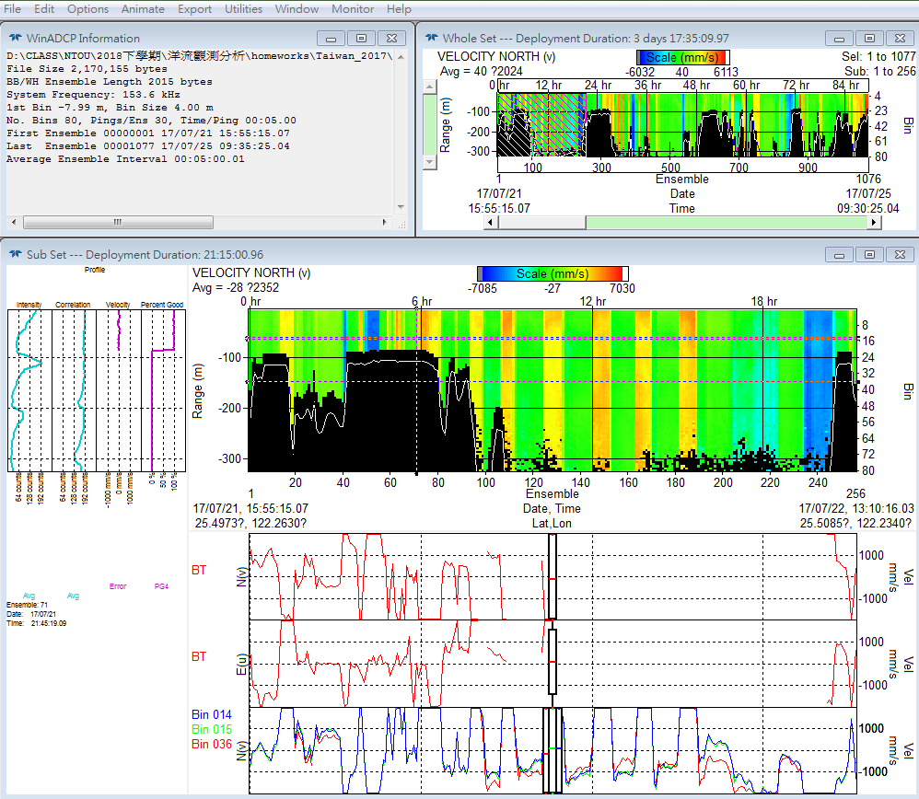
Reading data & Whole View

Slide 64
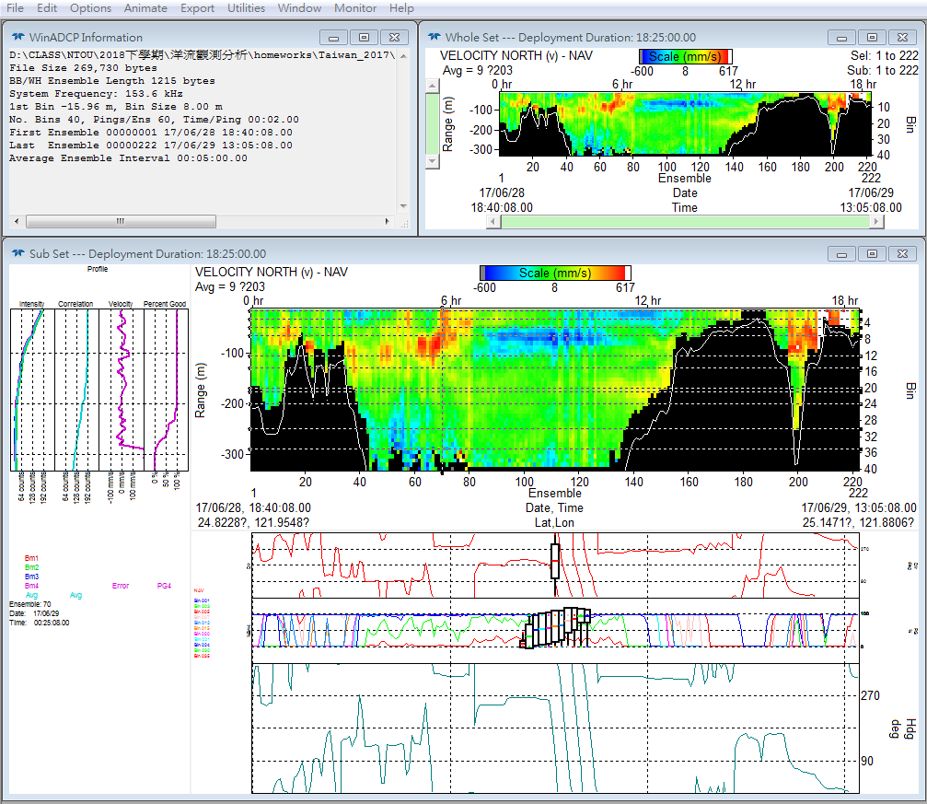
Function Bar

Slide 65
“Information” Window

Slide 66
“Whole Set” Window
Practice to show different variables

Slide 67
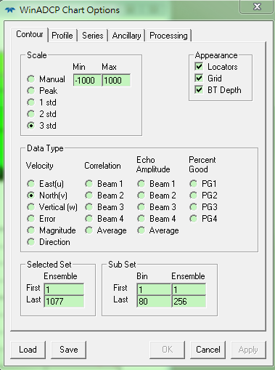
“Whole Set” Window
Select “Contour” tab

Slide 68
“Sub Set” Window
Three parts for the “sub set” window

Slide 69
Selected Set
Practice to show different variables
(Same as the “Whole Set”)

Slide 70
Profile Chart
1) Practice to show different variables.
2) Practice to select different profiles.

Slide 71
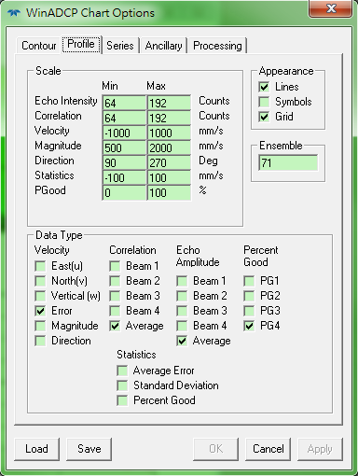
Profile Chart
Select “Profile” tab

Slide 72
Chart of Time-Series & Ancillary
1) Practice to show different variables.
2) Practice to select different profiles.

Slide 73
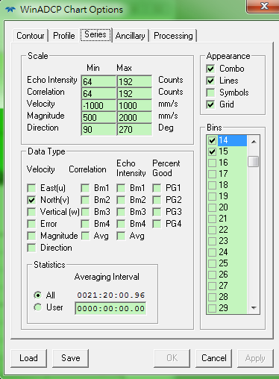
Chart of Time-Series & Ancillary
Select “Series” or “Ancillary” tab

Slide 74
Work to do
1) Install WinADCP
2) Read in ADCP data to WinADCP.
3) Output ship location (Navigation) to a txt file.
4) Plot ship track

Slide 75
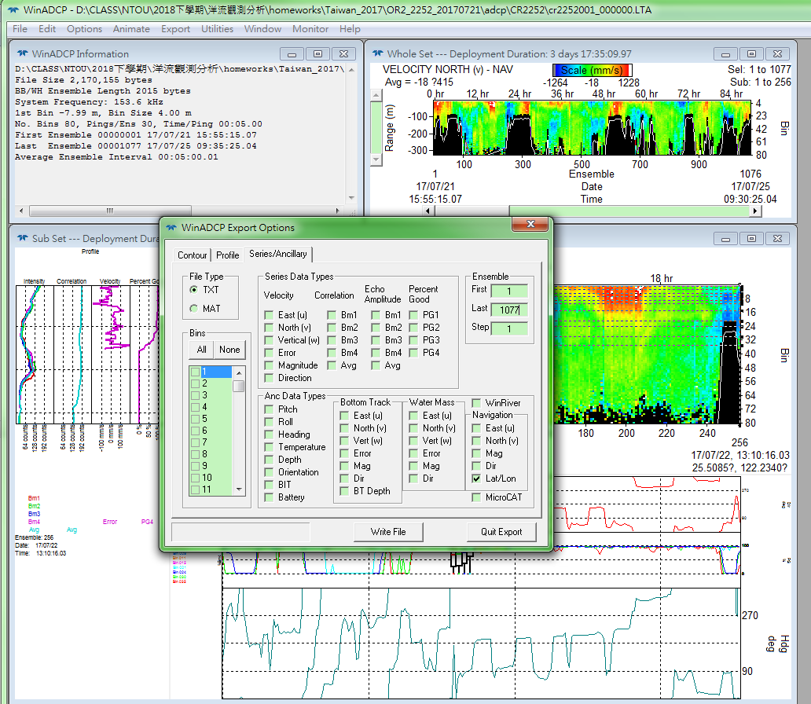
Output ship location (Navigation) to a txt file

Slide 76
Work to do
1) Install WinADCP
2) Read in ADCP data to WinADCP.
3) Output ship location (Navigation) to a txt file.
4) Plot ship track (Using your own tool: Matlab, Julia Language, etc.)

Slide 77
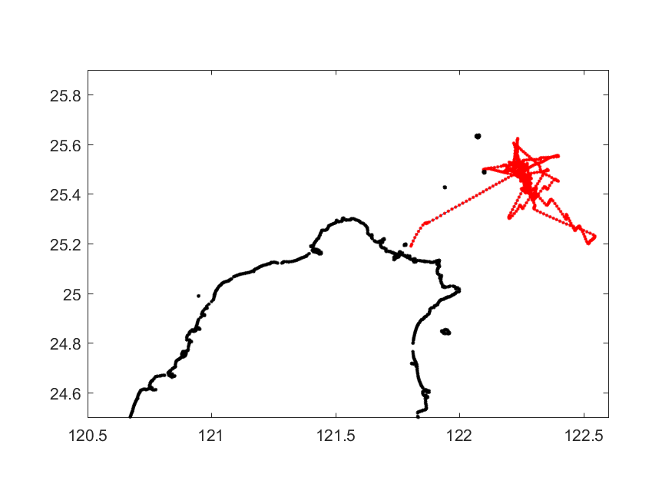
Plot ship track

Slide 78
Homework 6 (繳交期限: 2020/04/21) 遲交以50%計算
Using the ADCP data (cr2247001_000000.LTA) given in the server, plot the ship track. How long did the ship sail (in hours) based on these ADCP data?

Slide 79
No homework

